Slide 1
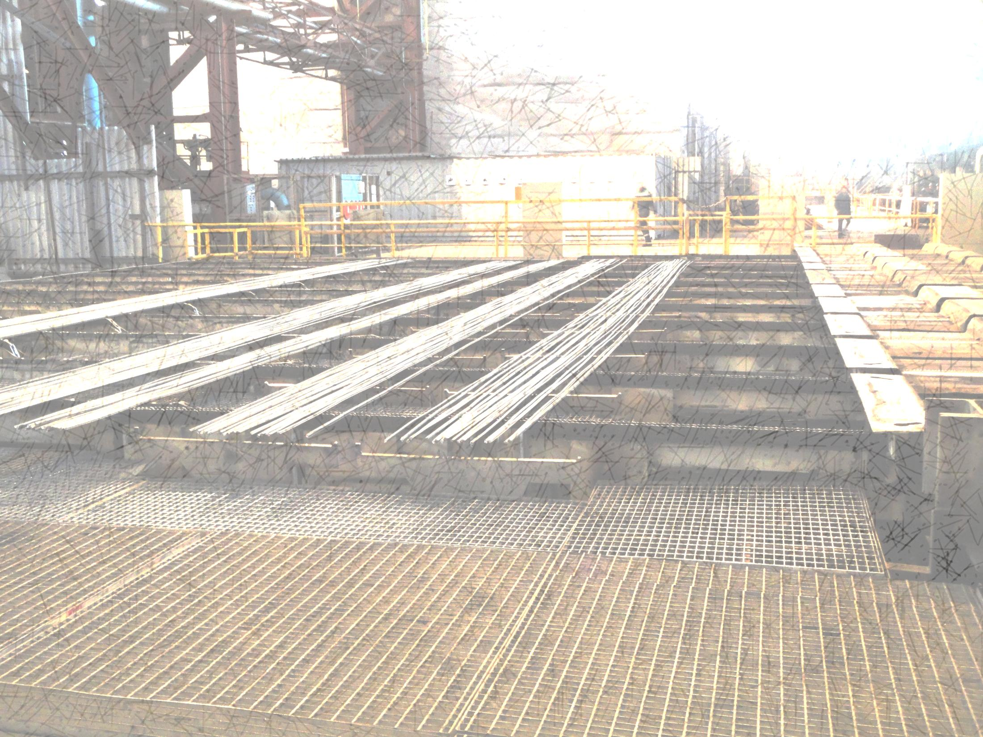

Modernization and Automation of Bar Mill

Slide 2

Bar Mill

Slide 3
HEATING FURNACE
4 separate furnaces heat the billets coming from BOF
16 PRESSING STANDS
Heated billets can be shaped into different forms.
COOLING STAND
Bars are cooled down and their quality can be improved
CUTTING
Long formed products are cut down according to requirement
PACKING
Final products are packed into bunches and loaded in trains

Slide 4
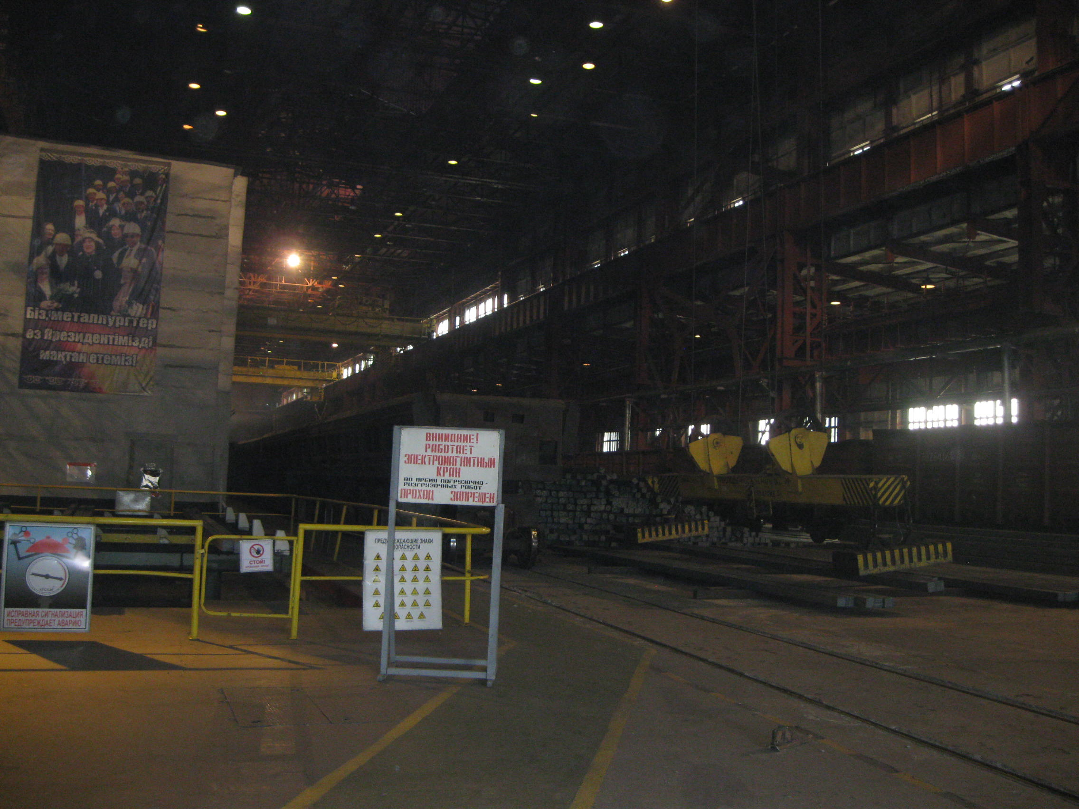

Entrance to bar mill

Slide 5
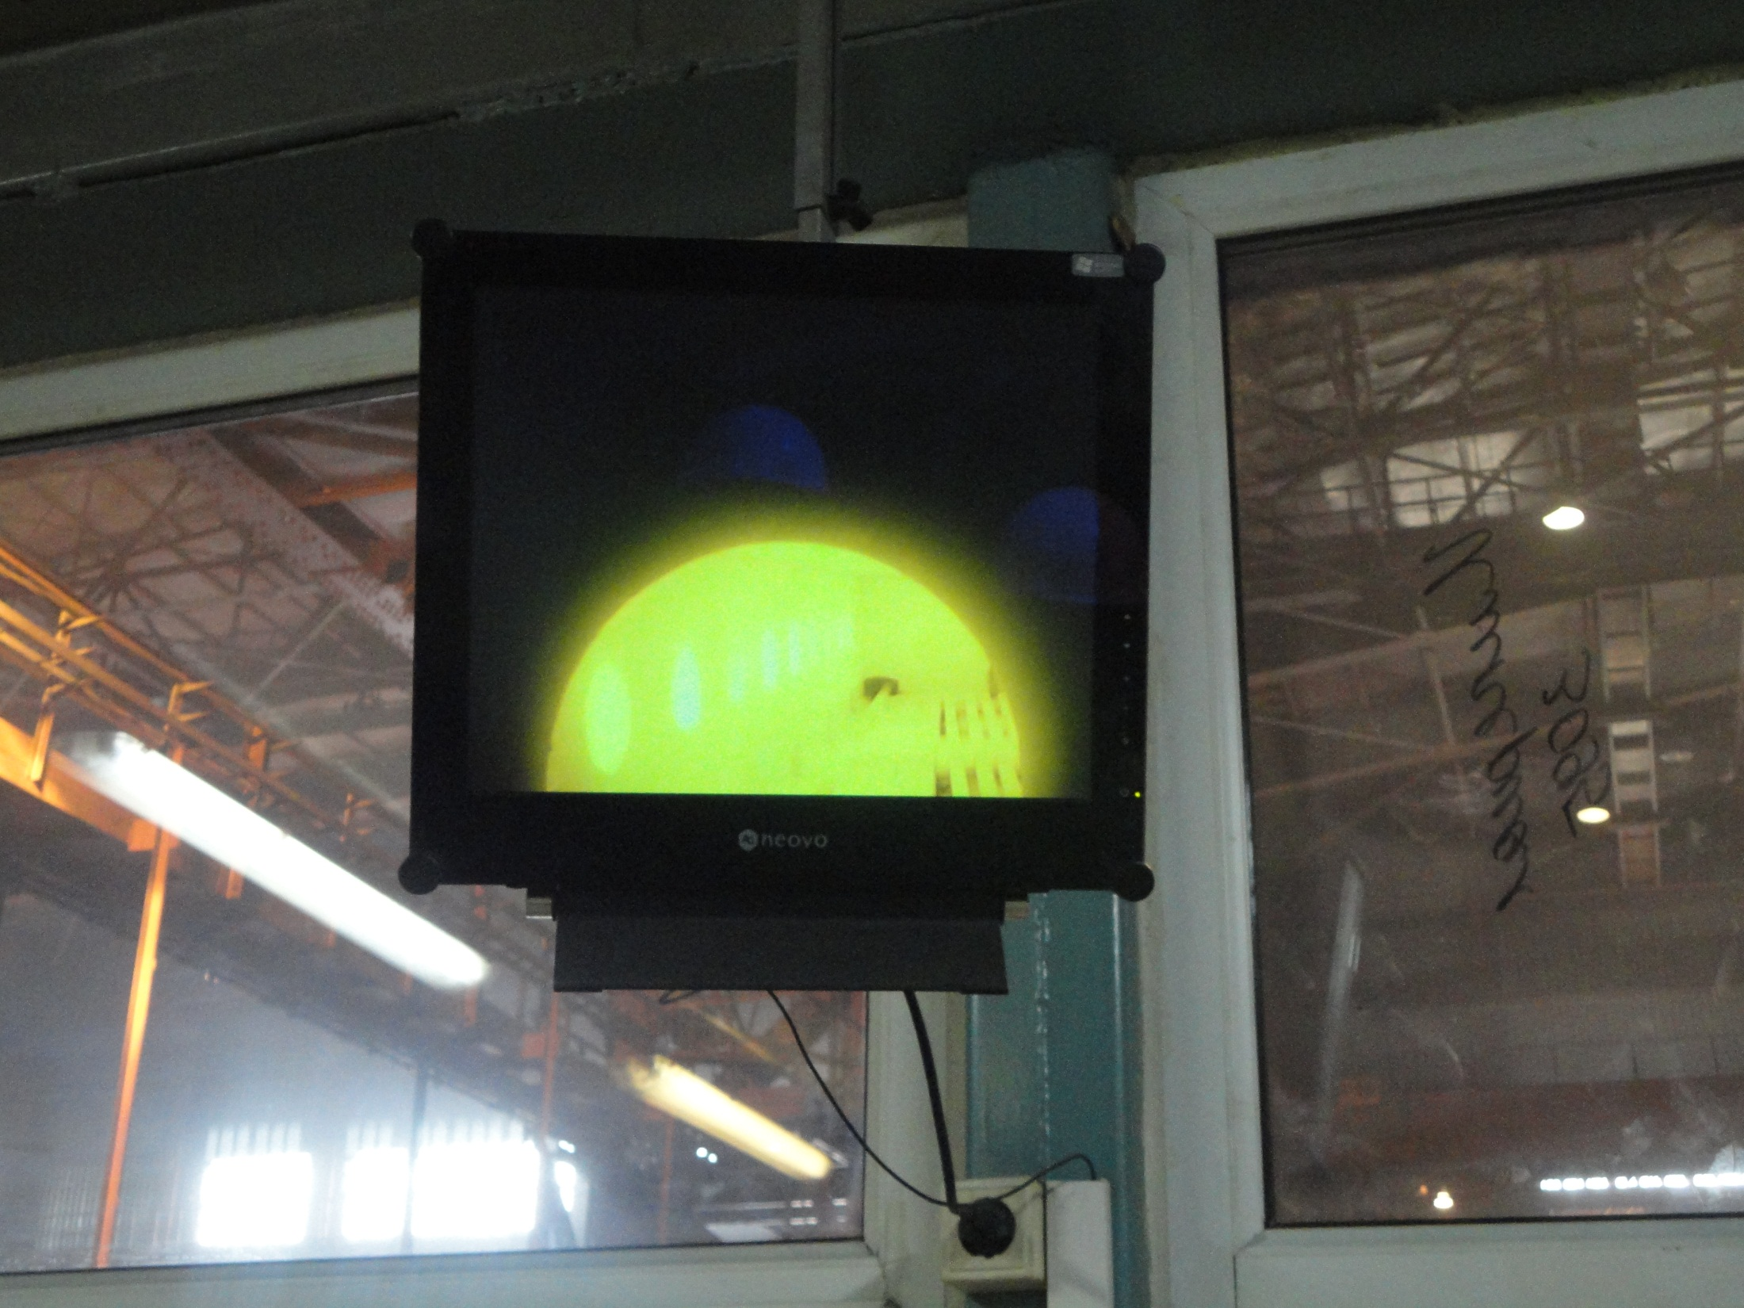
Inside view of heating furnace

Slide 6
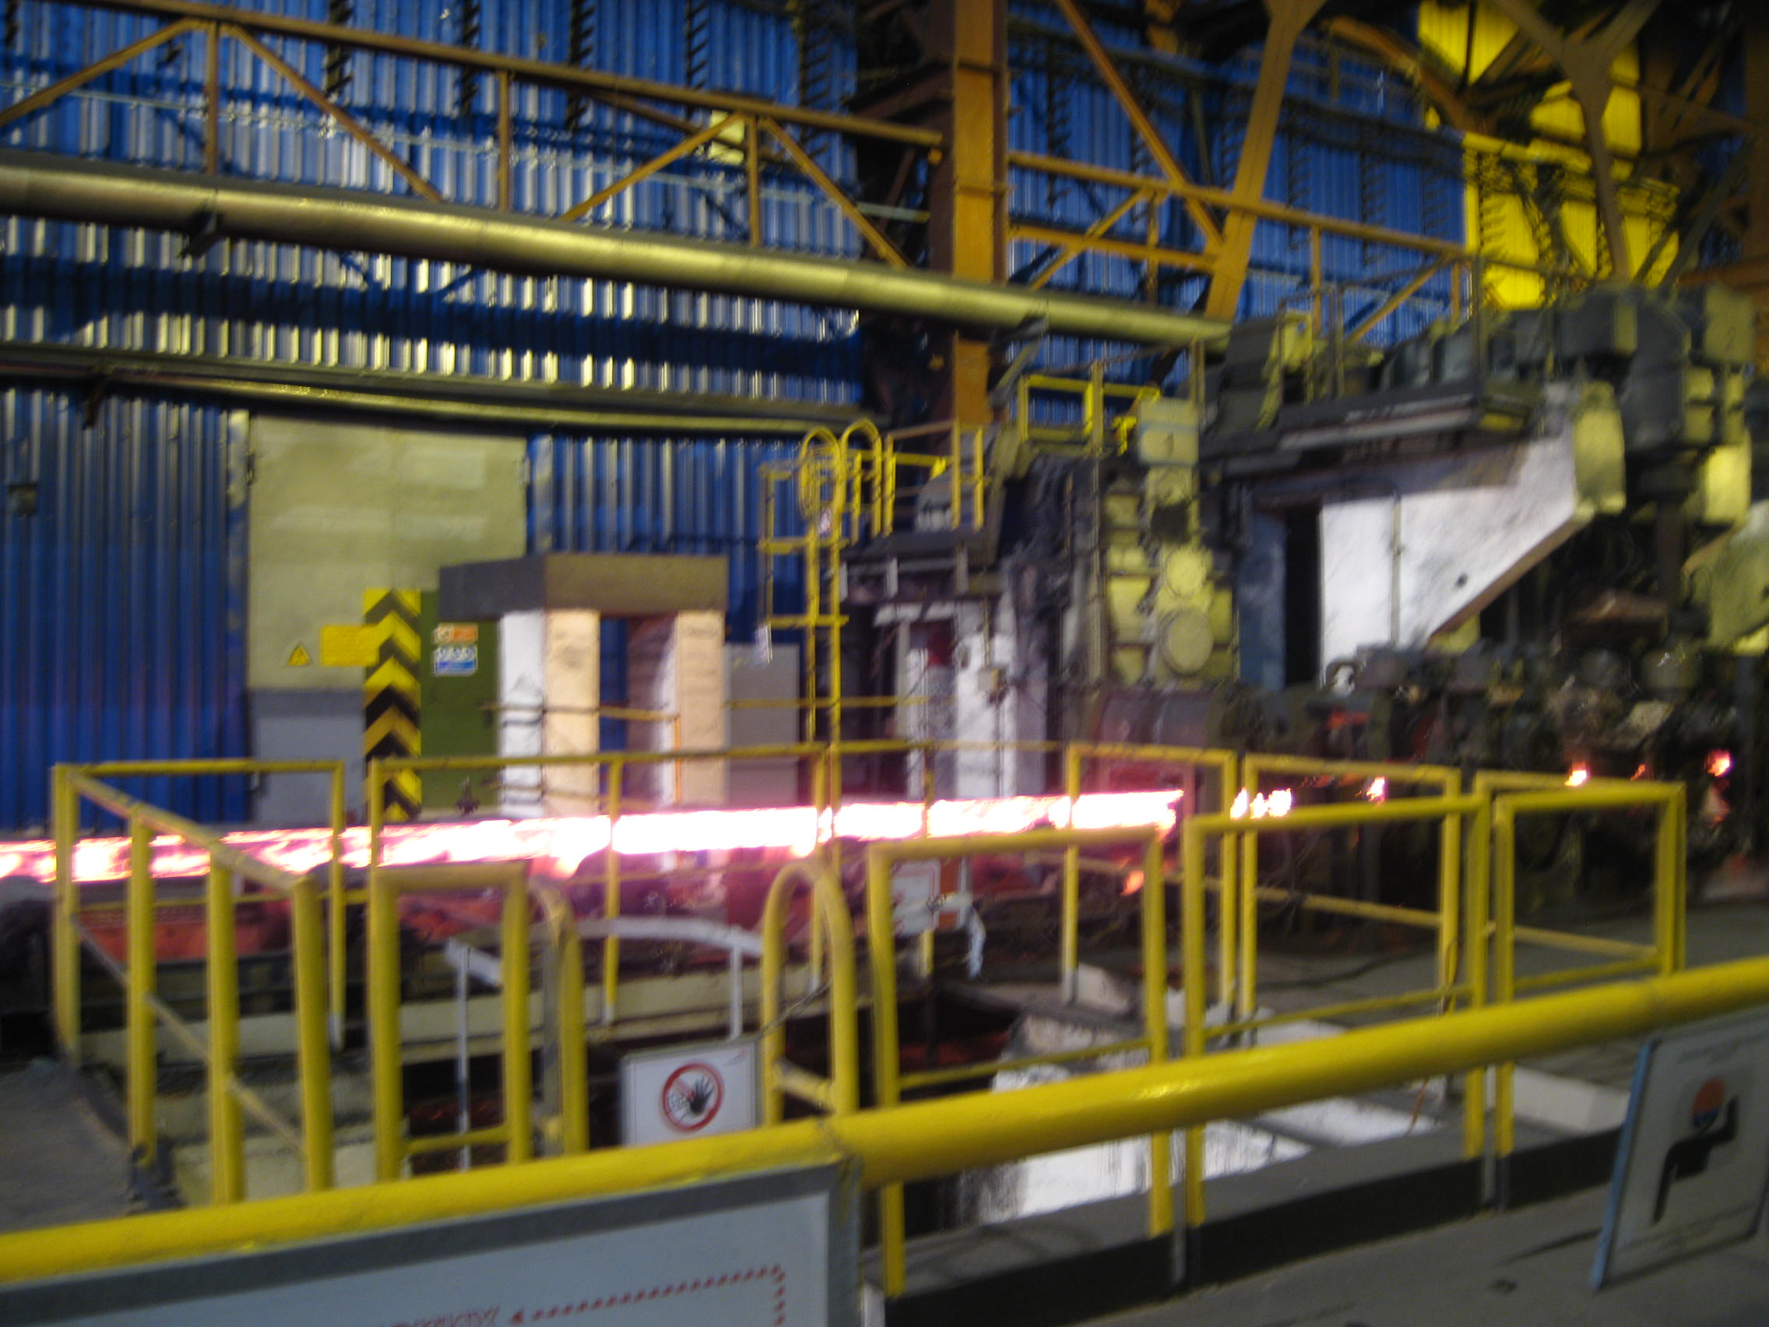
Heated billet

Slide 7
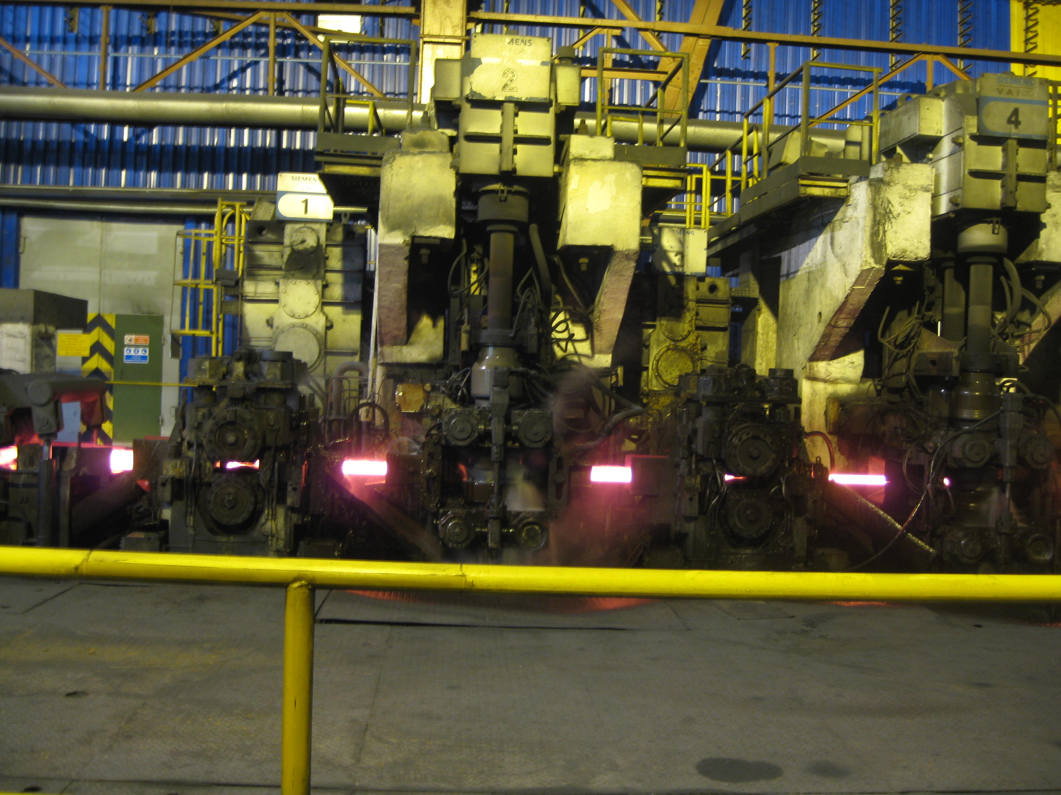
16 pressing stands

Slide 8
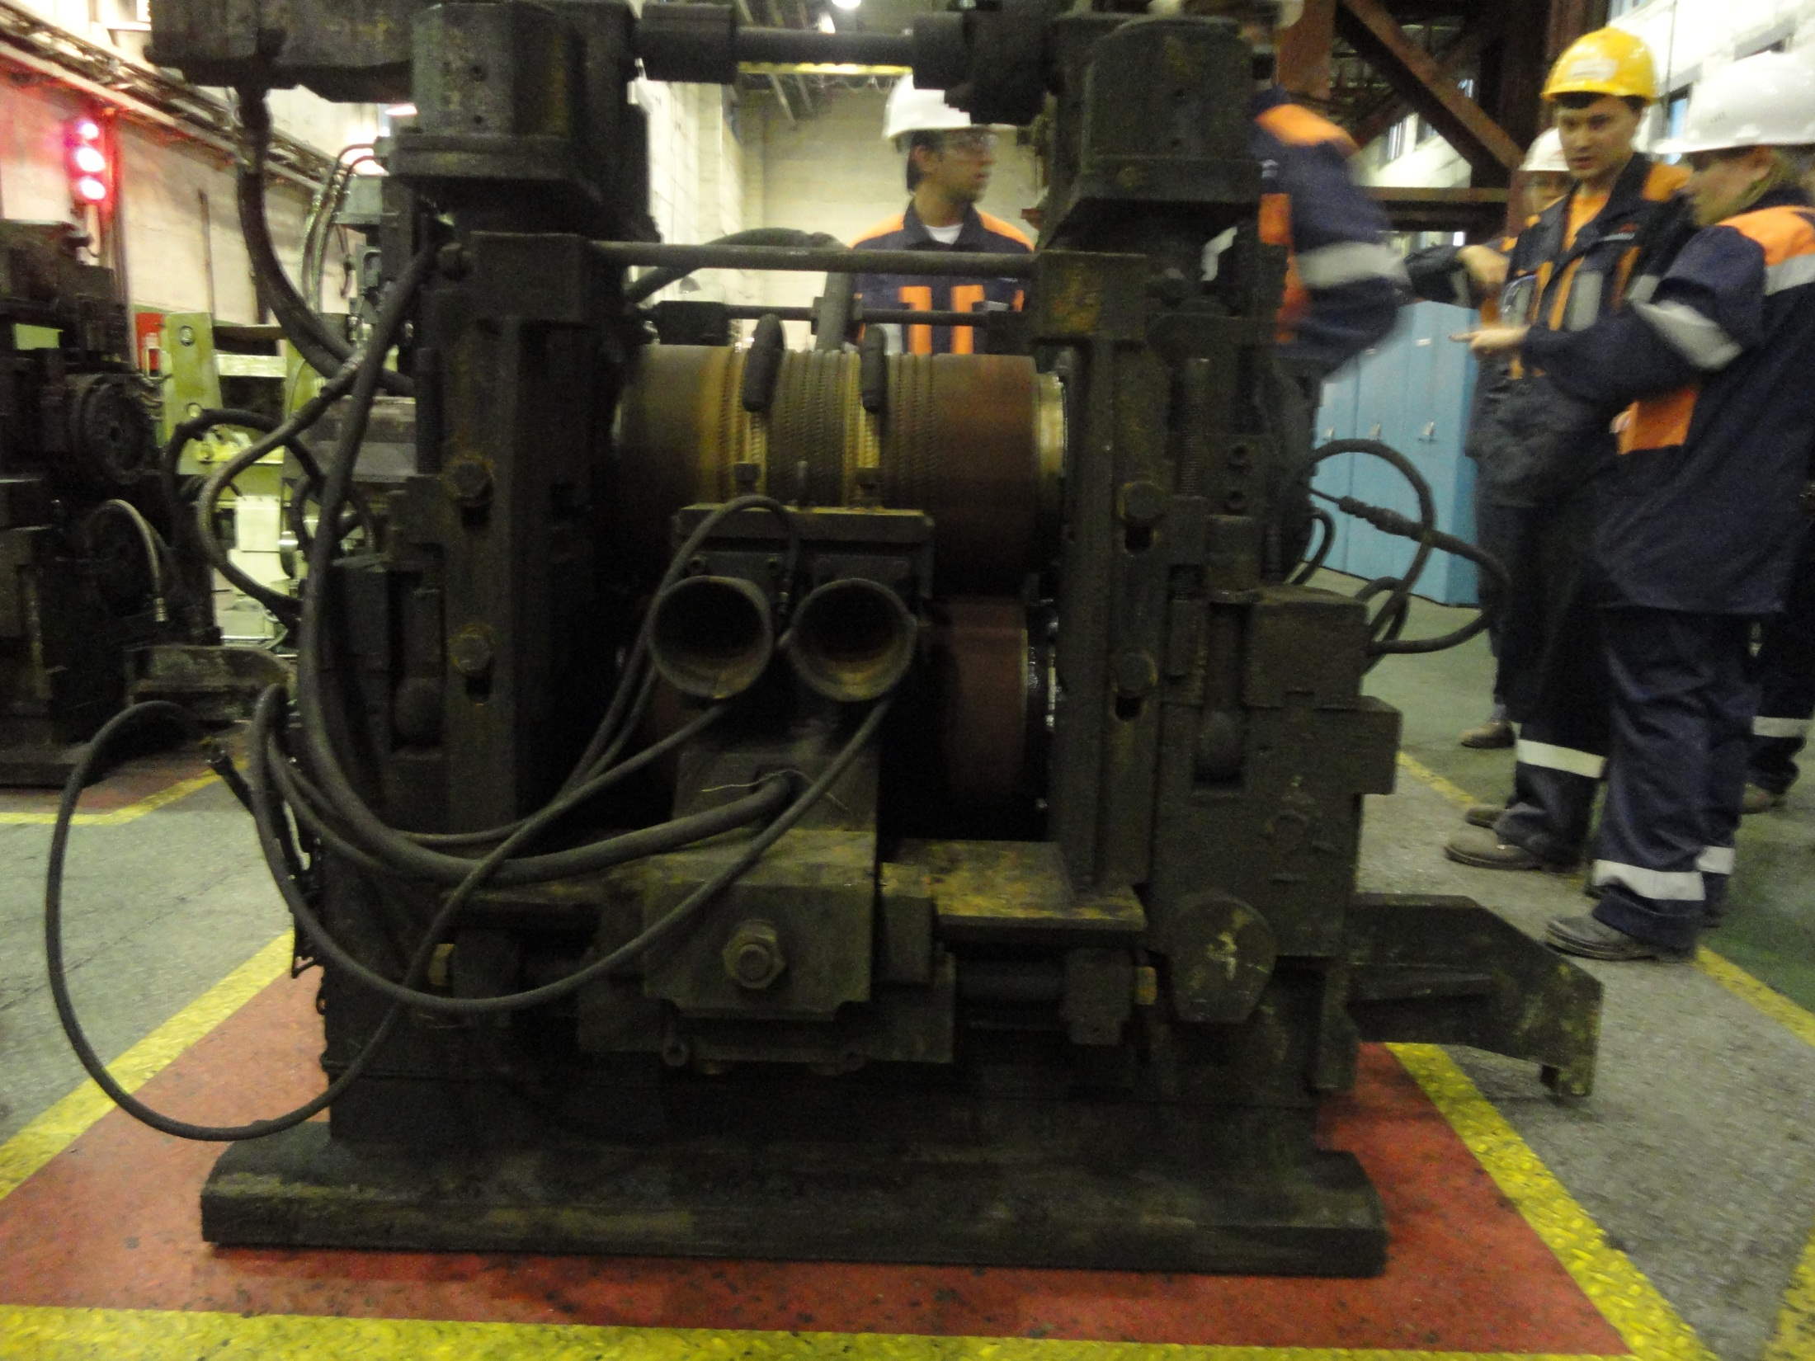
Close view of a stand

Slide 9
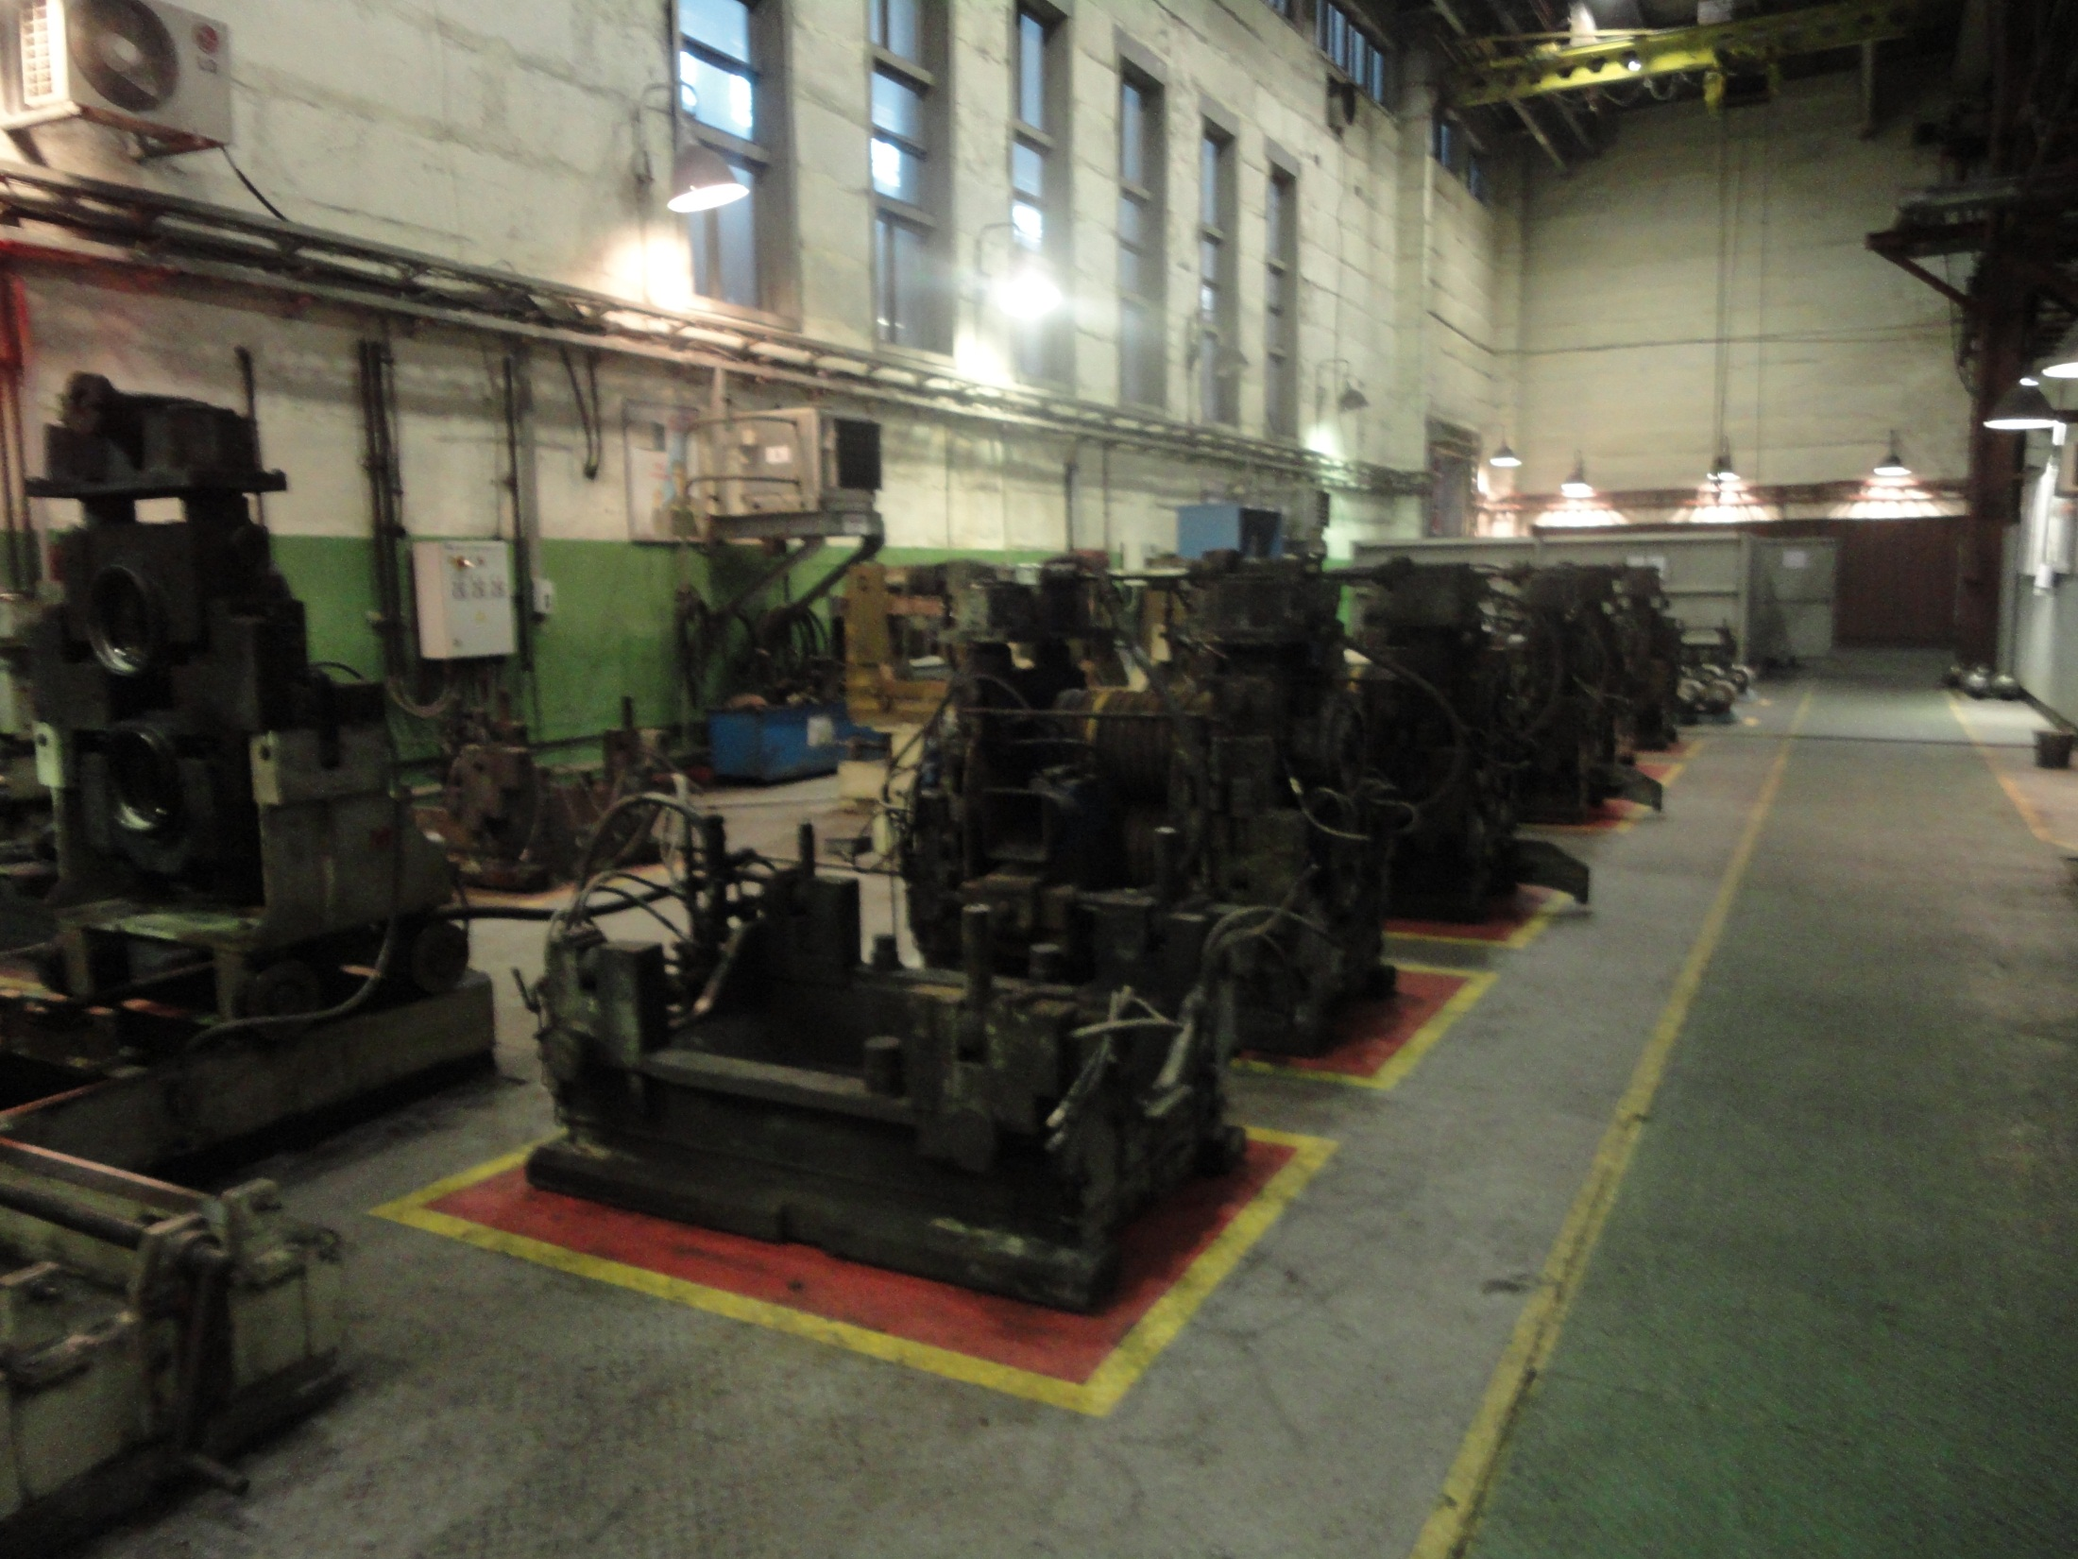
Close view of stands

Slide 10
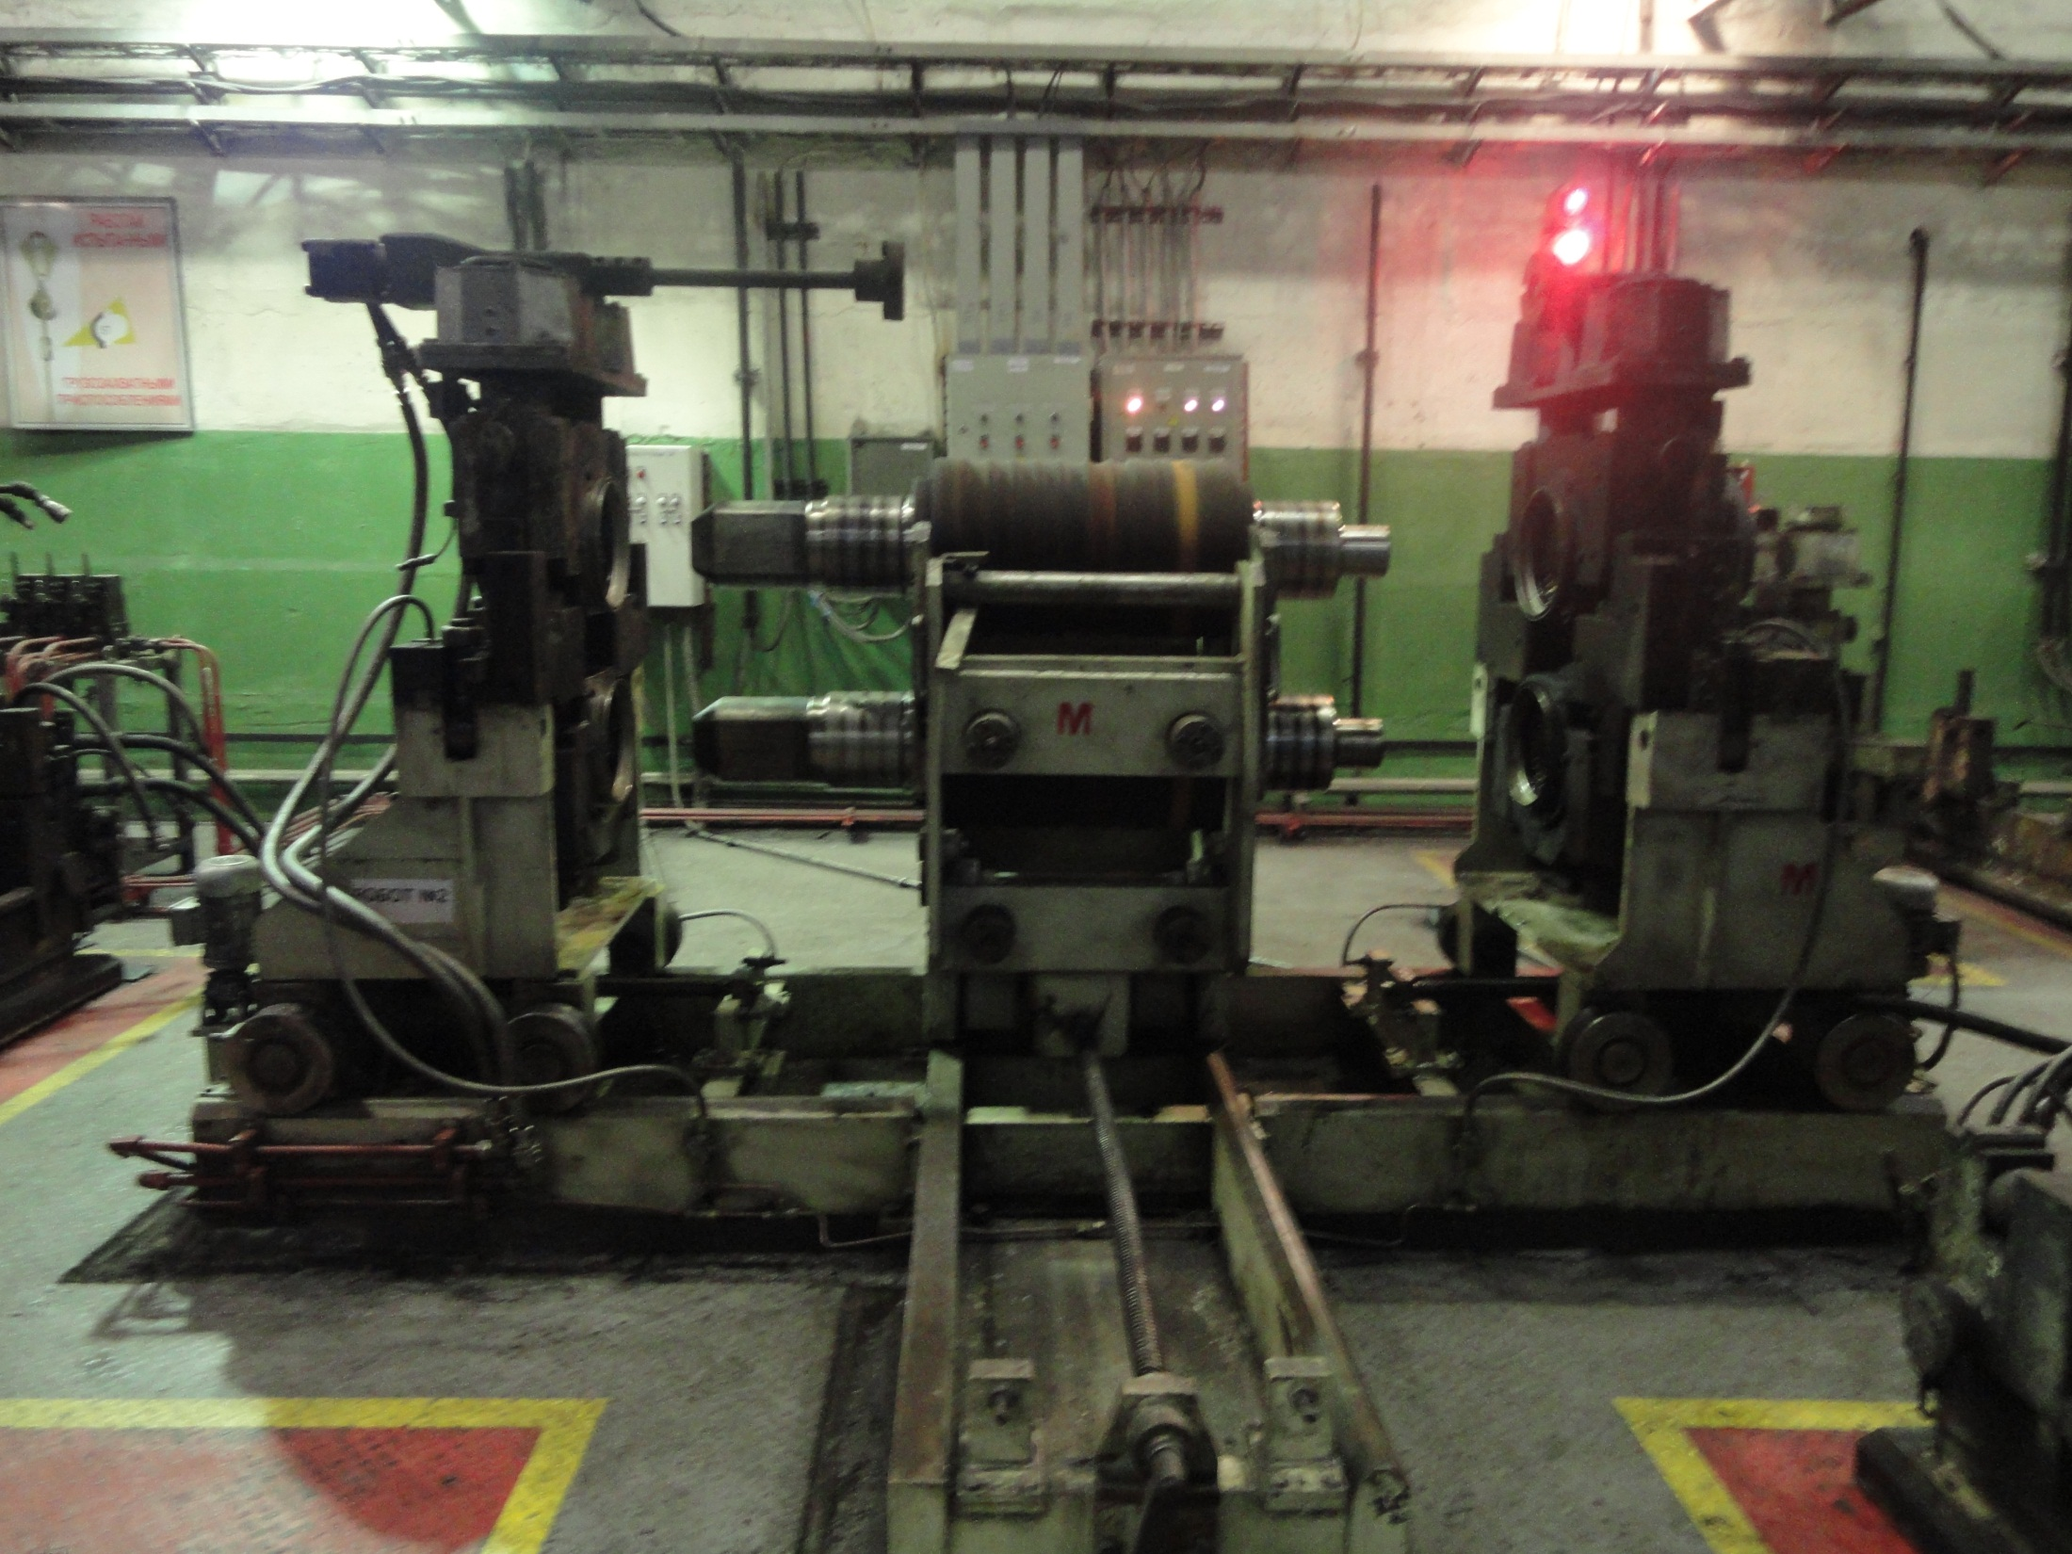
Close view of a stand

Slide 11
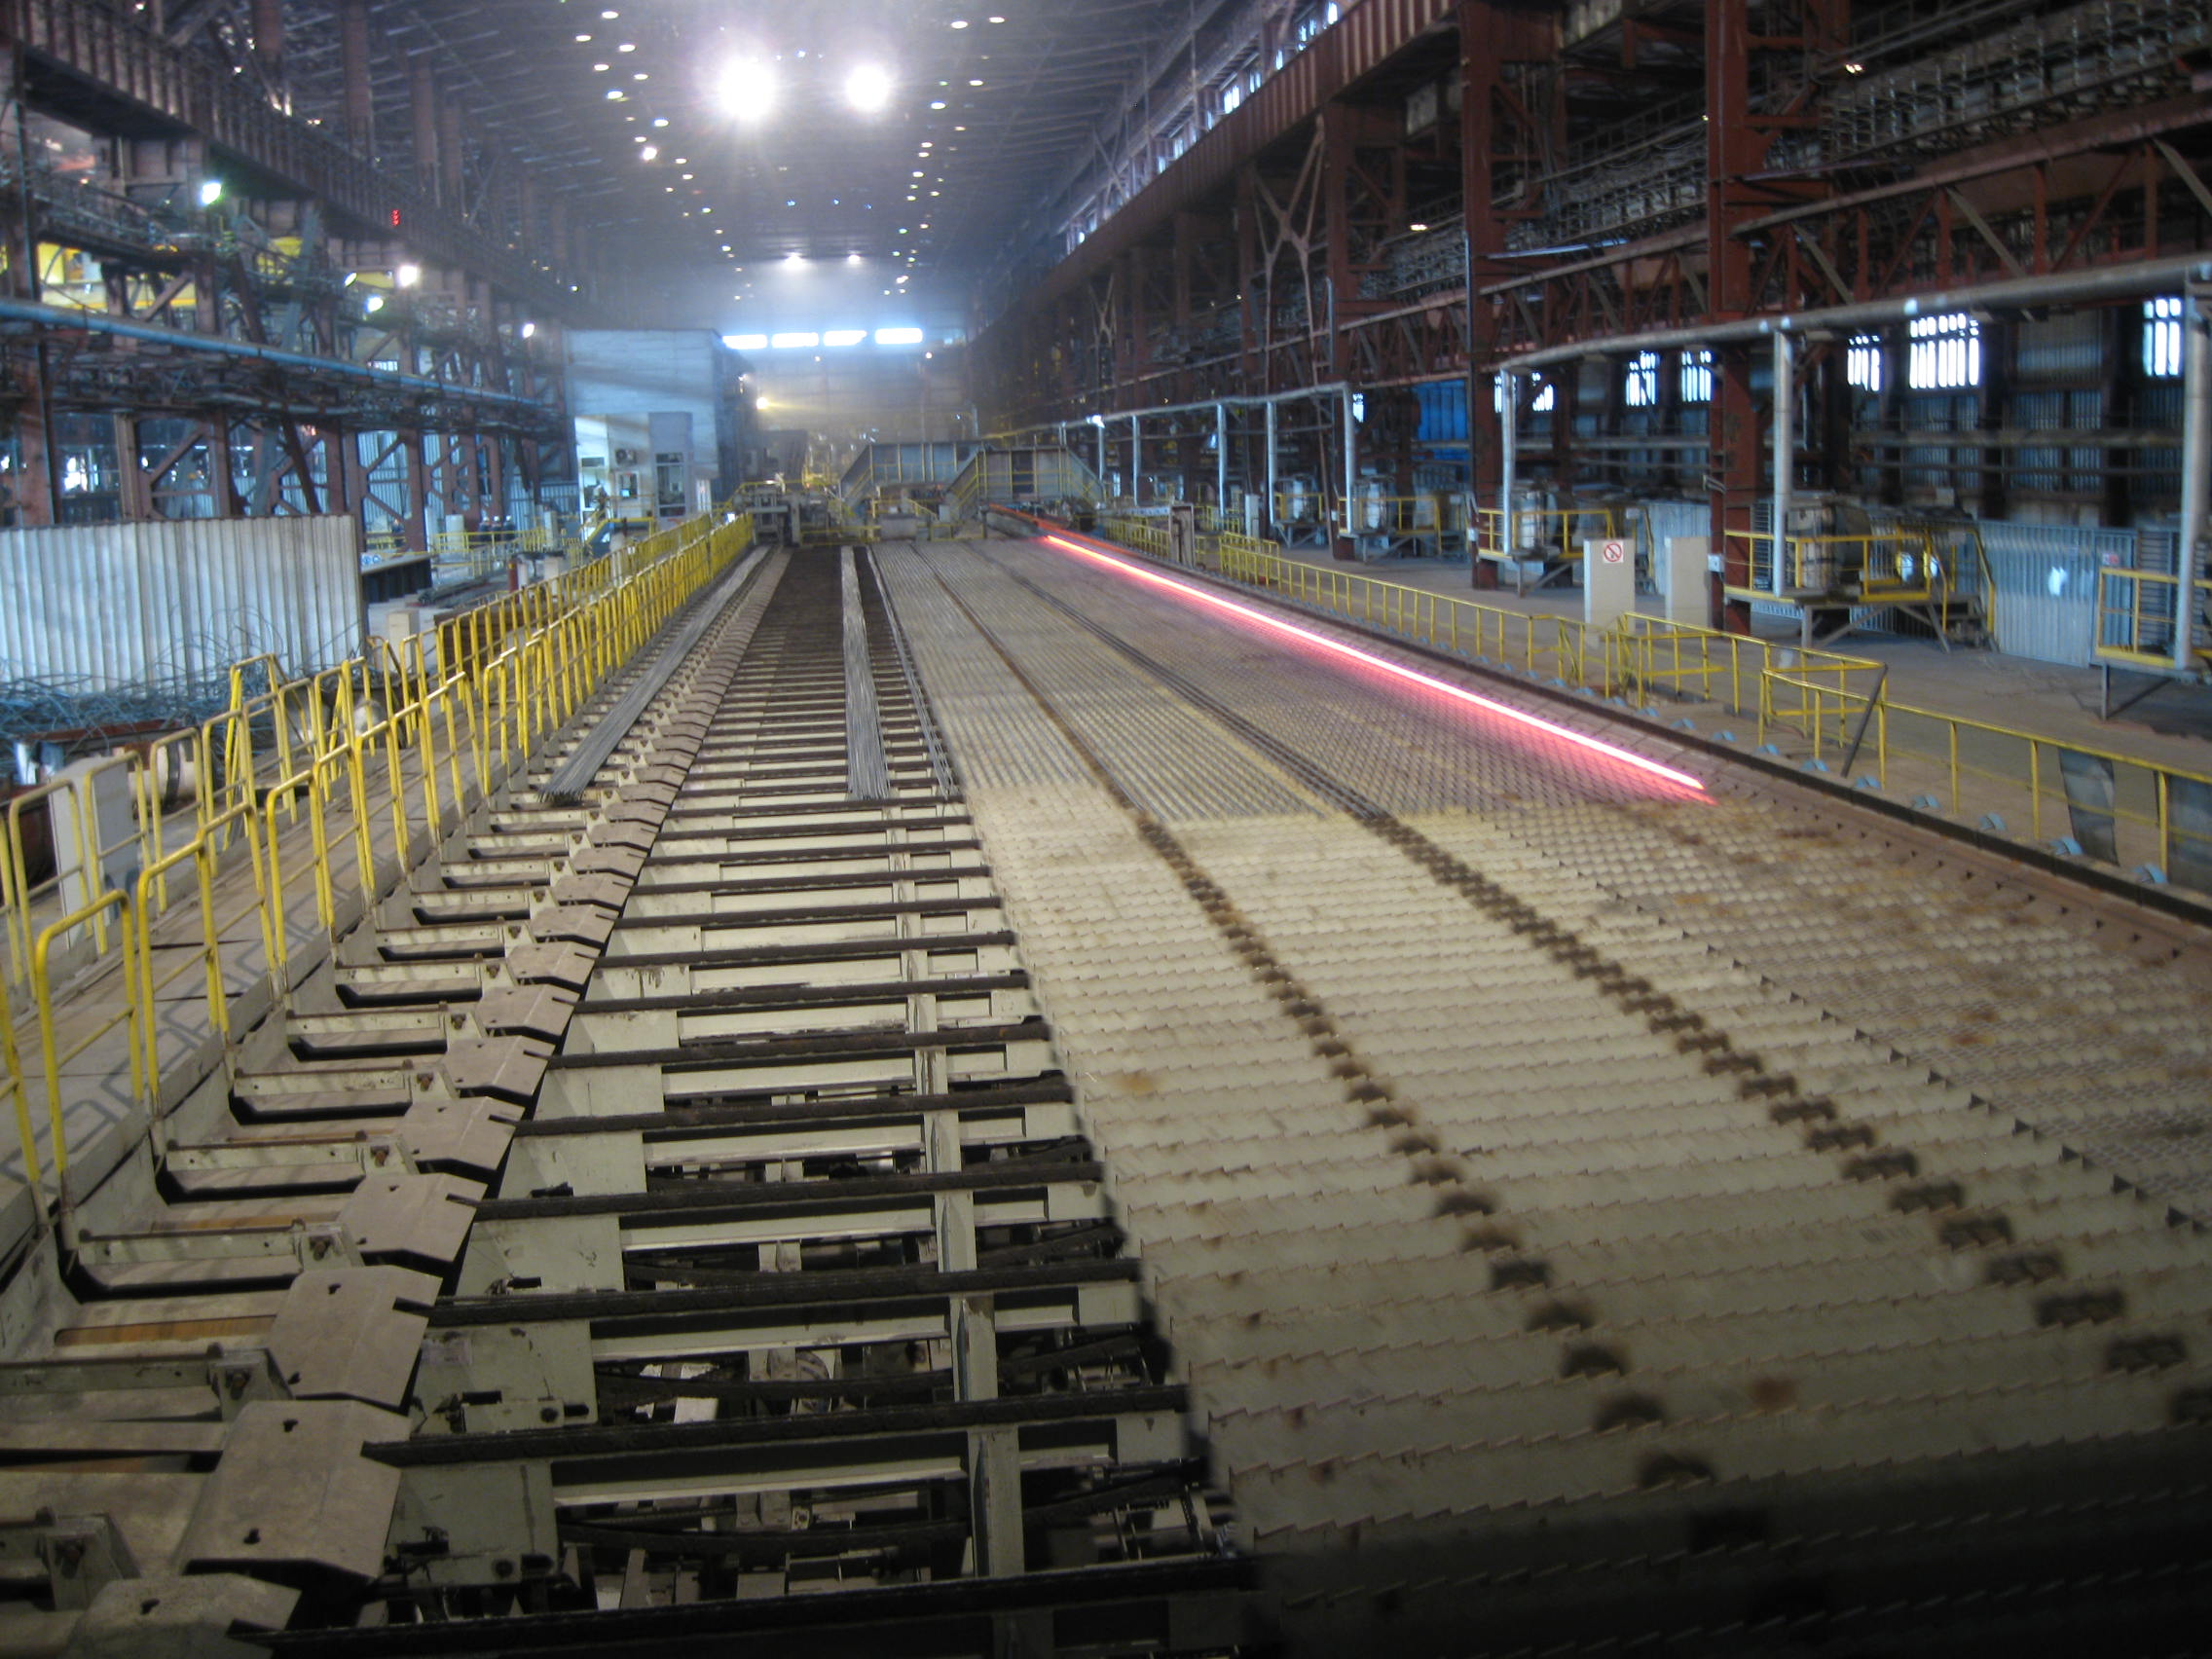
Refrigeration

Slide 12
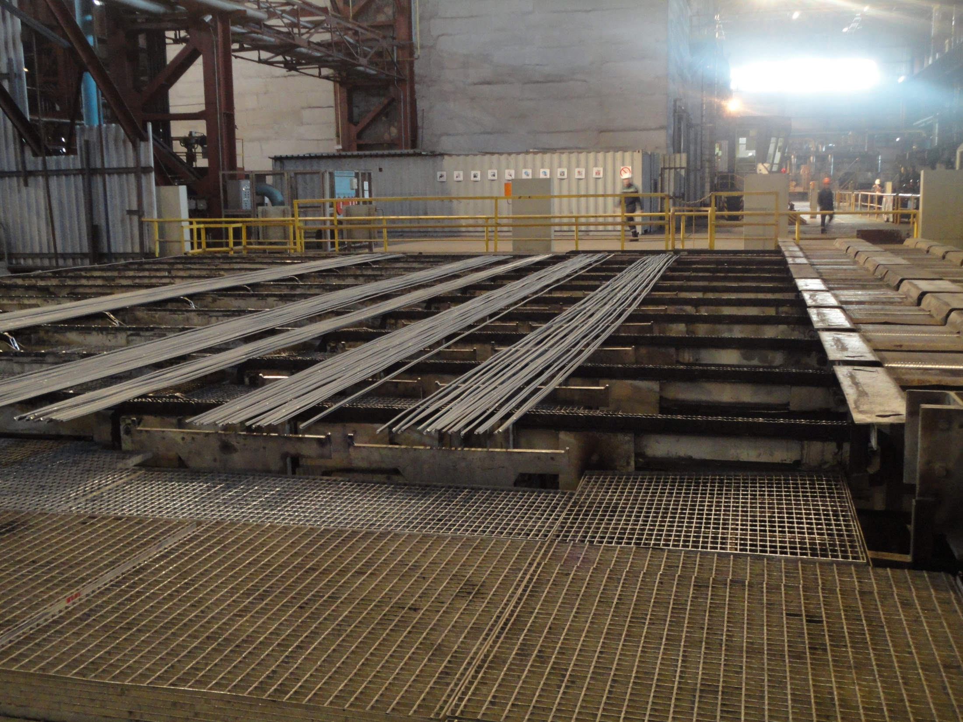
Long Bars ready to be cut

Slide 13
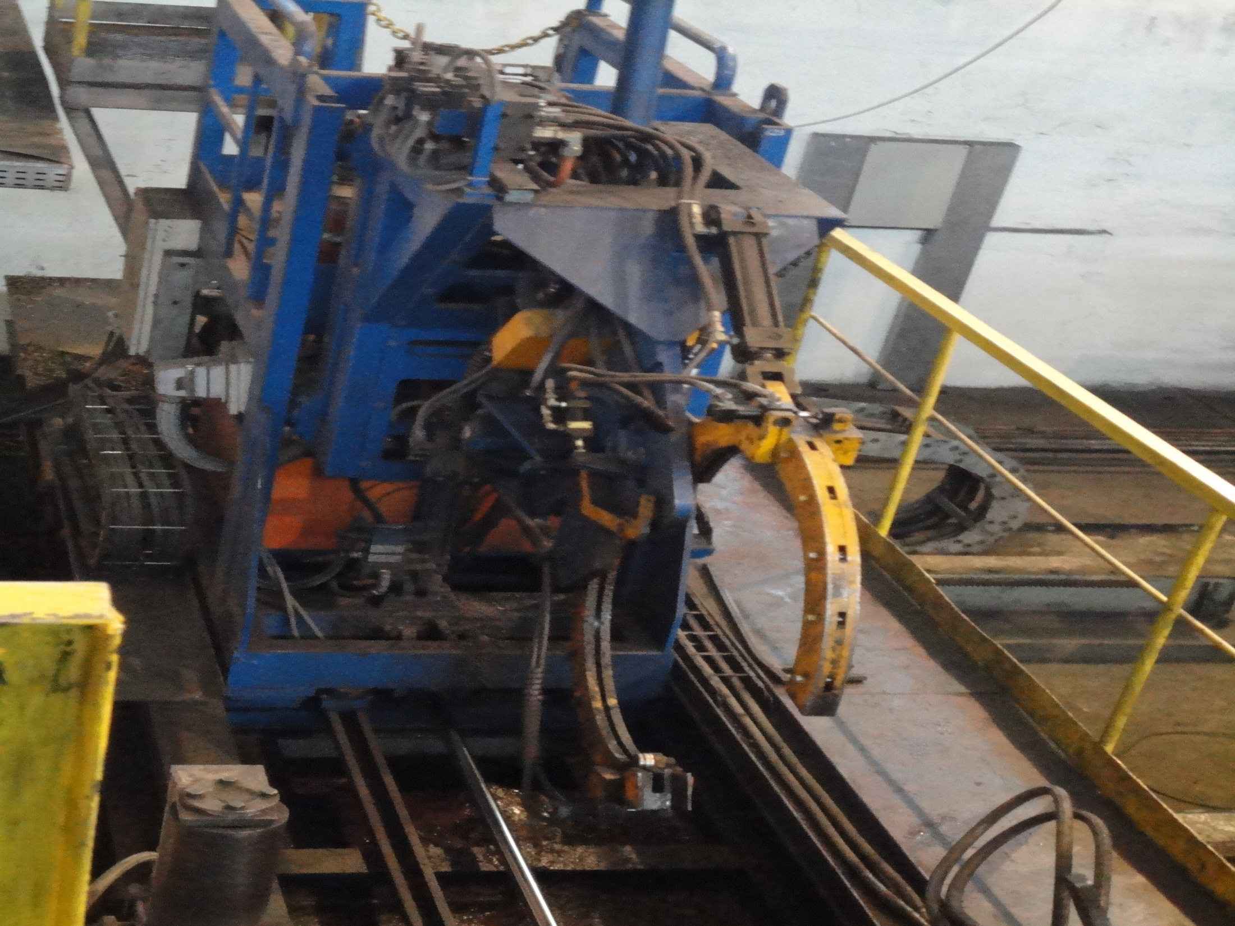
Cutting machine

Slide 14
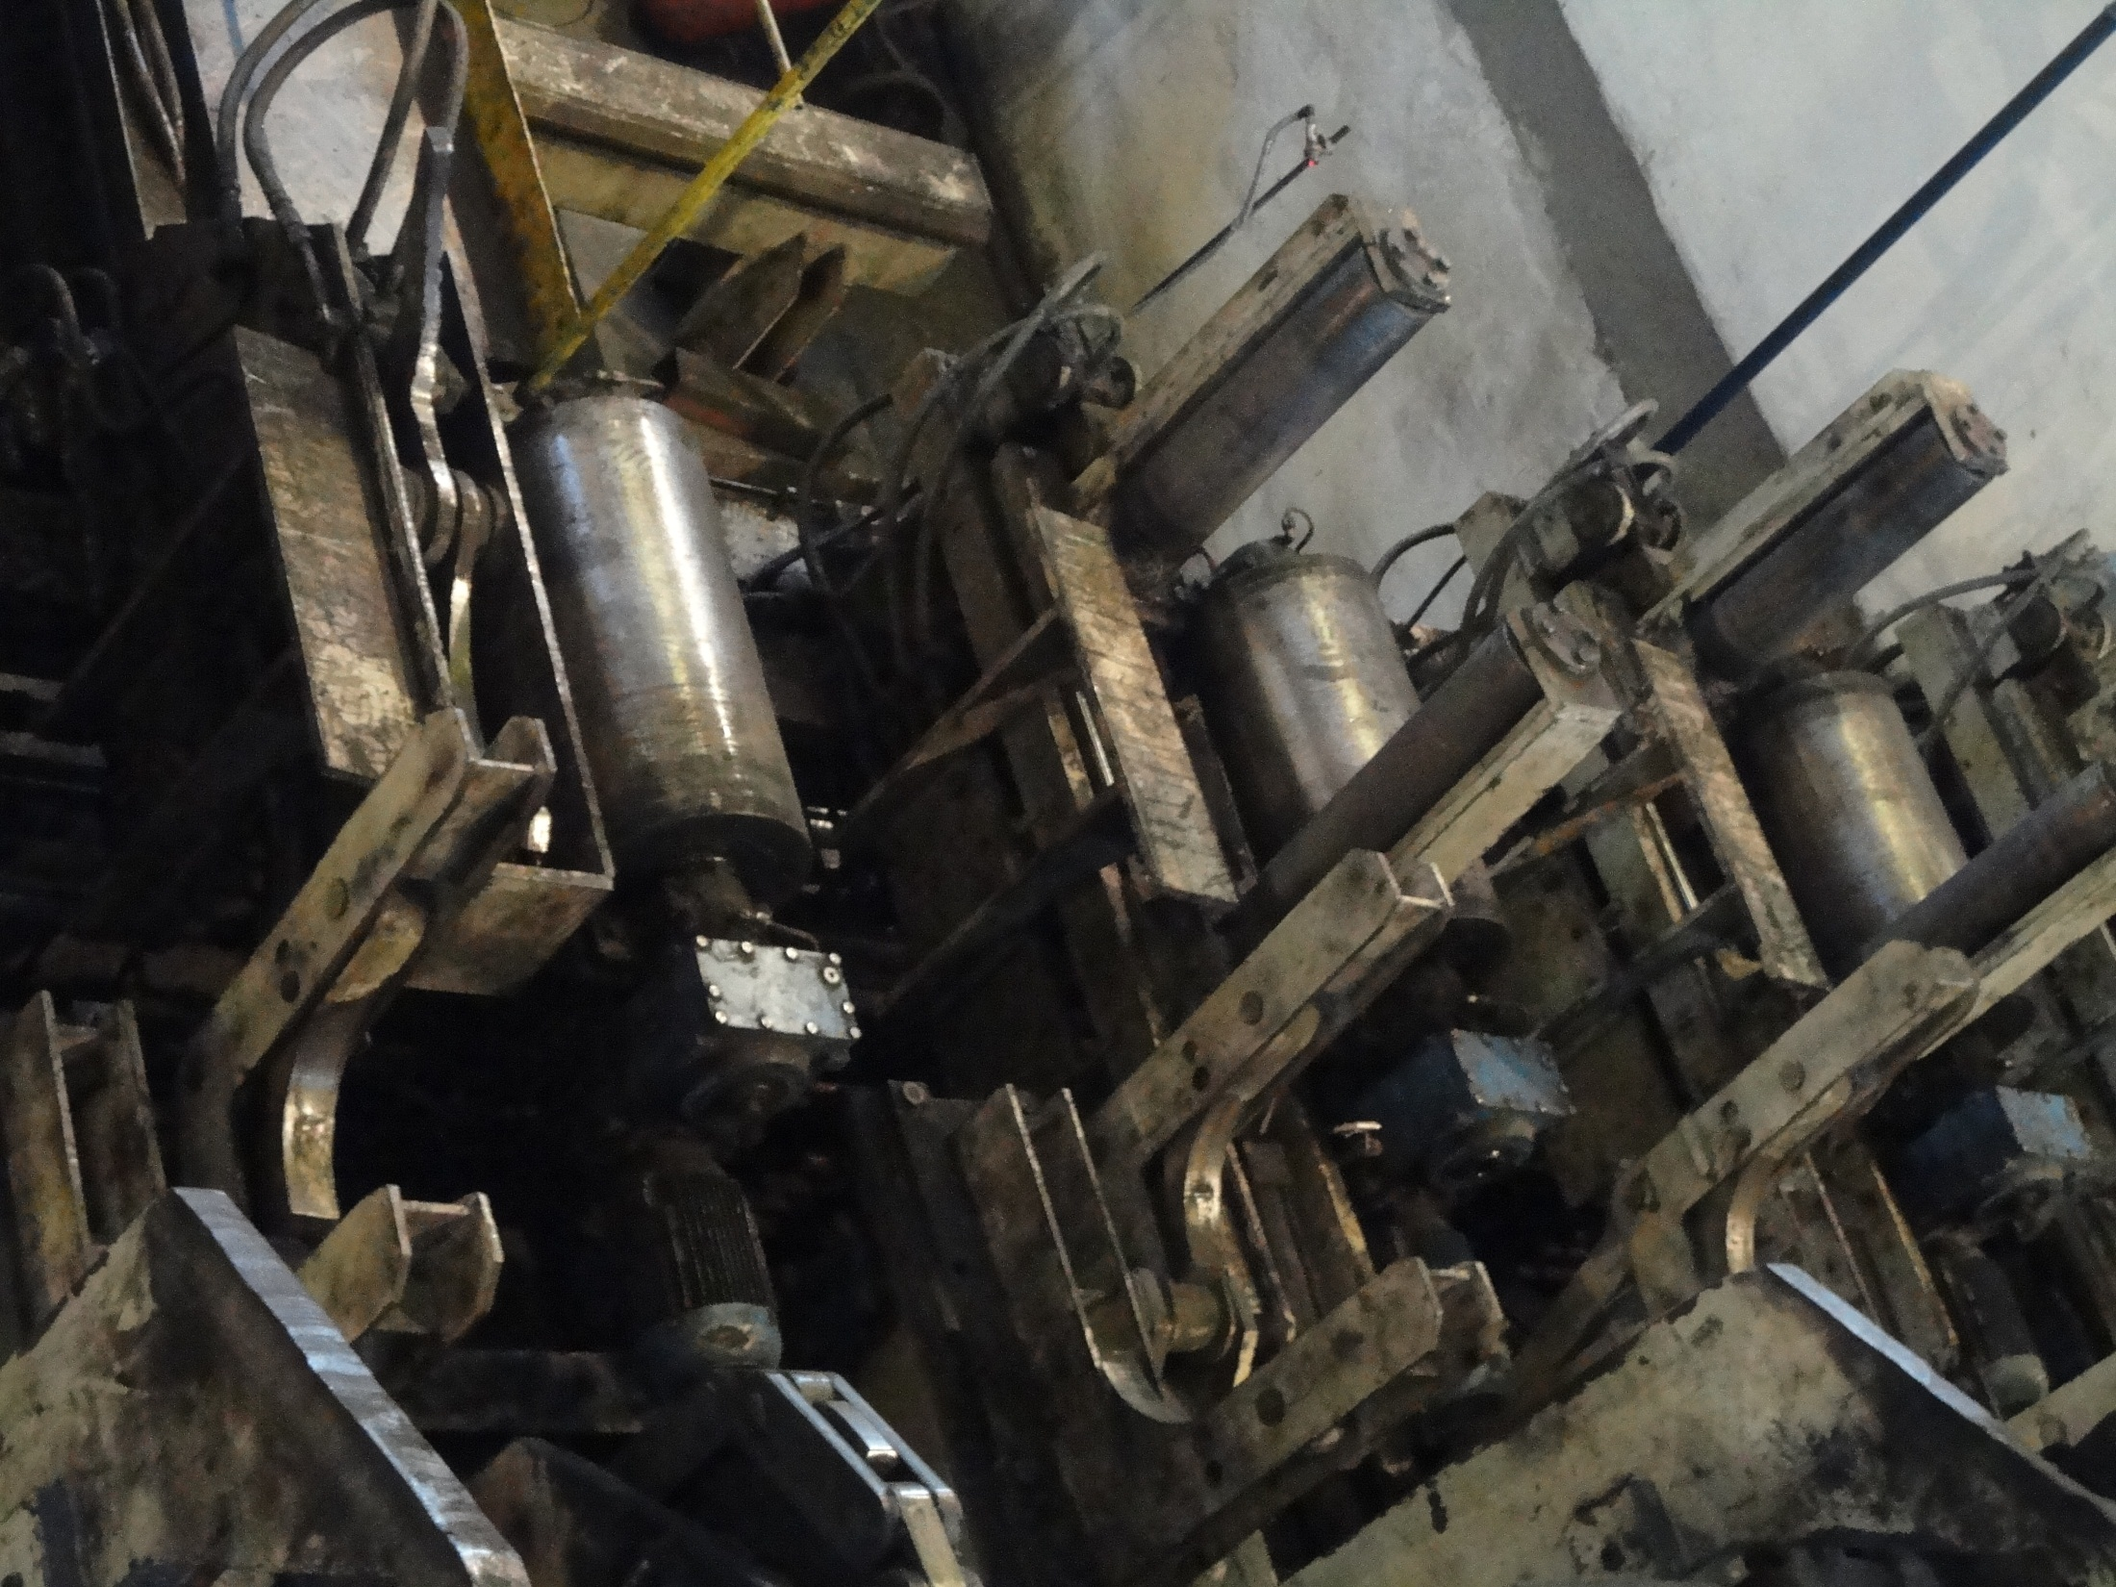
Rollers

Slide 15
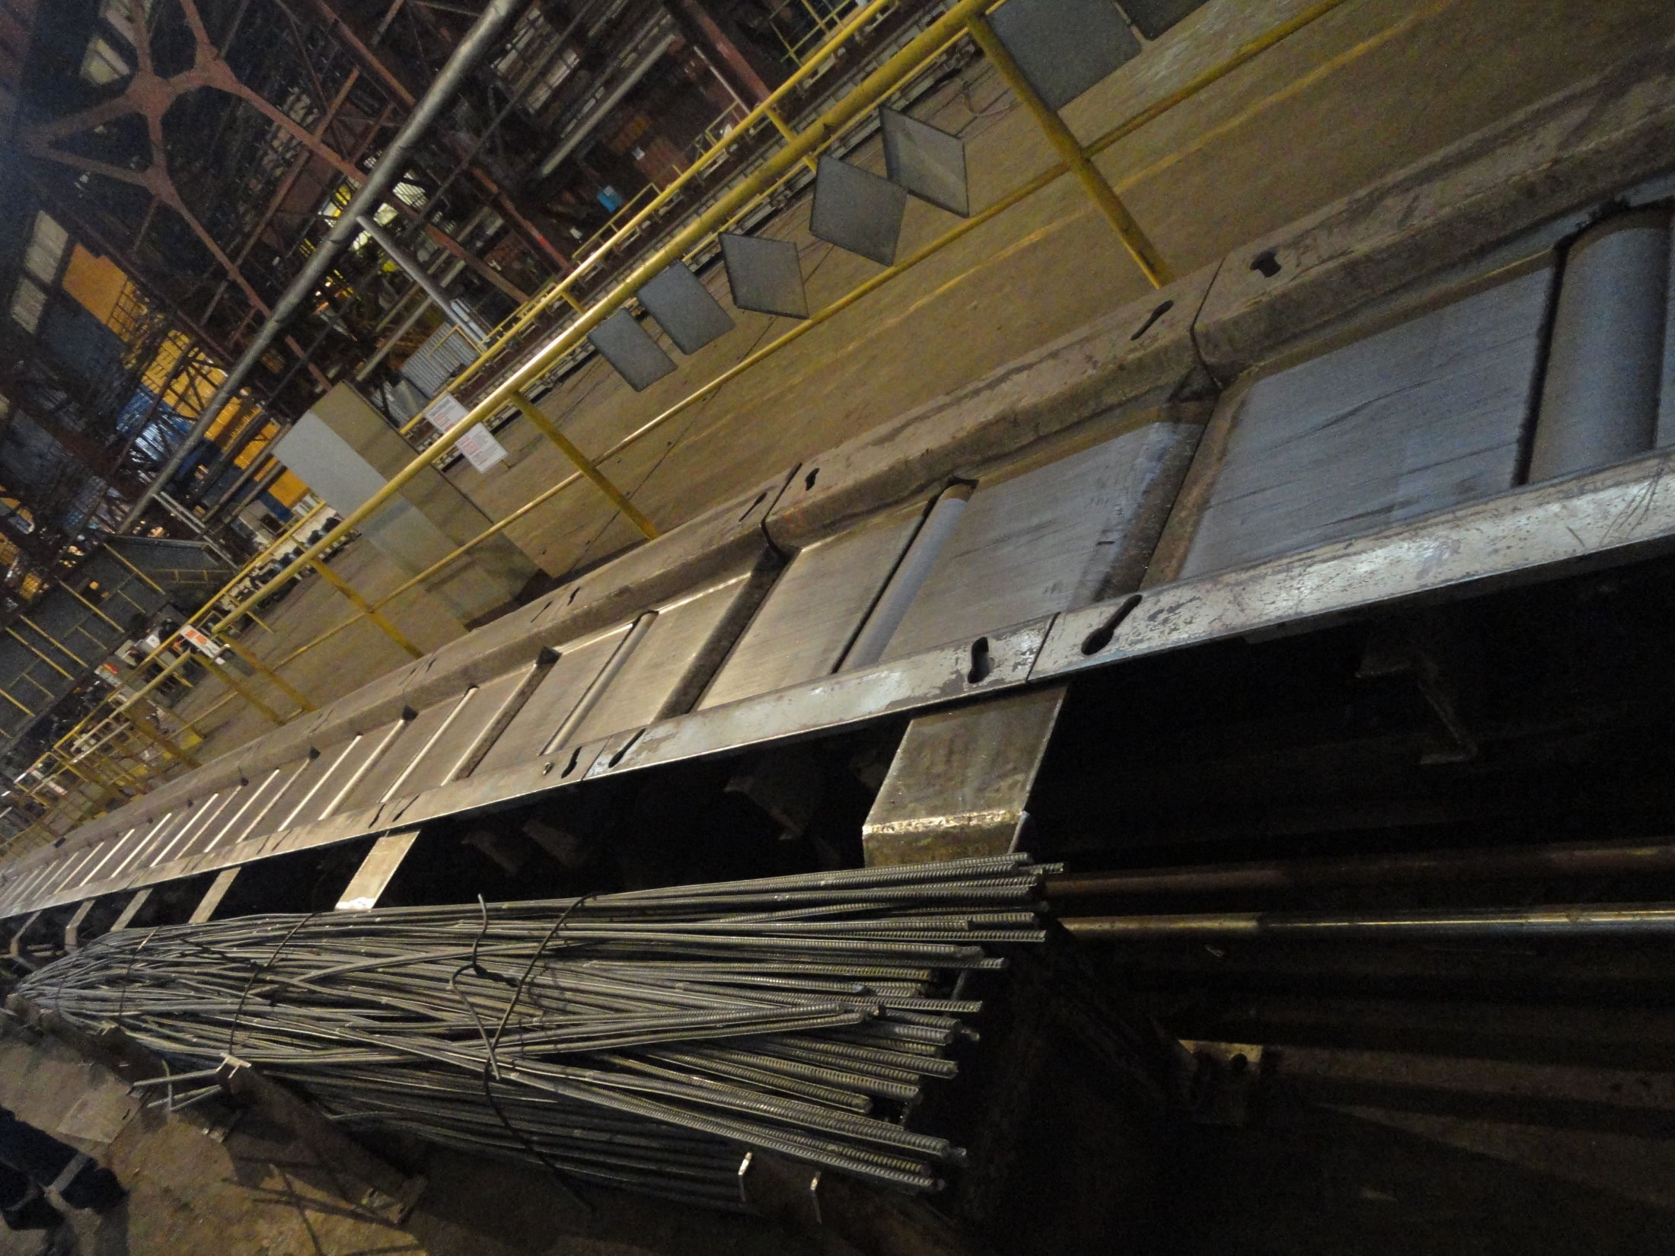
Packing

Slide 16
Cooling station
4 underground pumps.- amongst which maximum 3 can work. M1 and M2 work always. And M3 and M4 are used when any one of them is destroyed.
In each pump there is one gate valve which is automatic and another valve which is manual generally used for repairing purposes.
This underground station is a connecting network to the cooling station above the ground and they are connected via a position valve.
This position valve plays the main role in regulating the water flow rate hence controlling the pressure.

Slide 17
3 sections of cooling stand
After finishing stand the temperature that is before cooling is about 250.304 degrees.
After 3rd stand the temperature of bars is 554.427 degrees.
Length of bars after first two stands is the same. But the length can be altered in the 3rd stand according to the required diameter.
Last stand is particularly used to roll smaller diametric bars since here the water and air pressure are lower as compared to the rest two.

Slide 18


Project
Problem statement
To automatically set the two main parameters i.e. 1. Water flow rate
2. Water pressure
in cooling station for better quality and enhancement of bars.

Slide 19
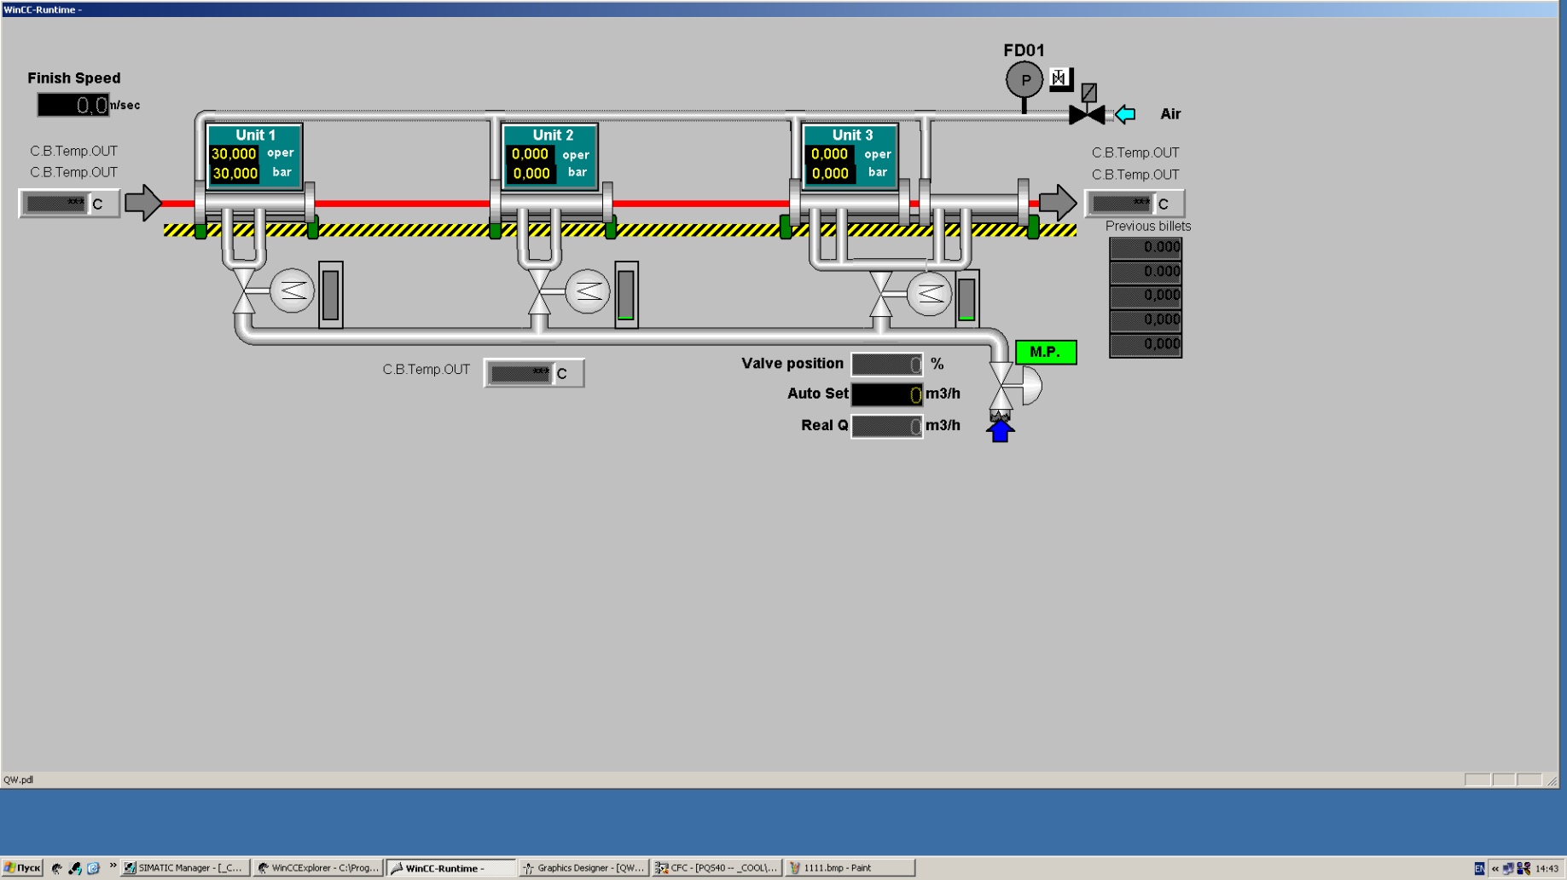
WinCC Layout

Slide 20


Our Aim
We have a pressure sensor in the above mentioned cooling station to sense the incoming water pressure.
Further this pressure is compared with the pressure given by the operator. If it is not equal to the given pressure the 3 regulators adjust the valve outlets accordingly to make them equal.

Slide 21
CFC Chart

Slide 25
Networks

Slide 29

Presented by:
Natasha Goyal
Shubhi Gupta
Sumit Gautam
Vikas Mangal

